Slide 1
SOC MMC FPGA Board
Date 2007.5.9
SMT RnD Div 2

Slide 2
Contents
MMC FPGA Board
FPGA Block diagram
P/O

Slide 3
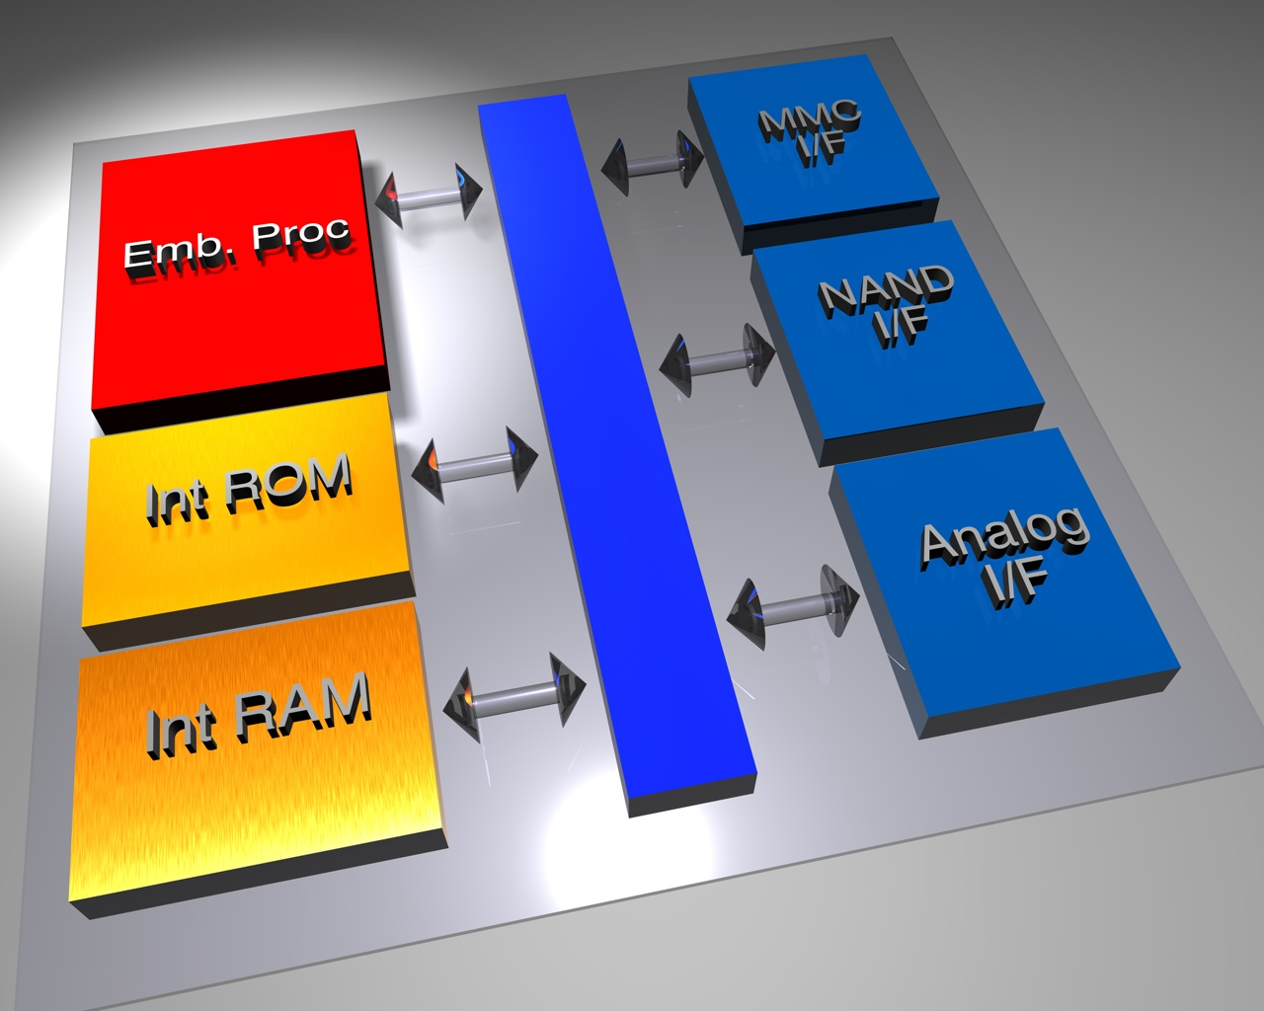
block diagram

Slide 4
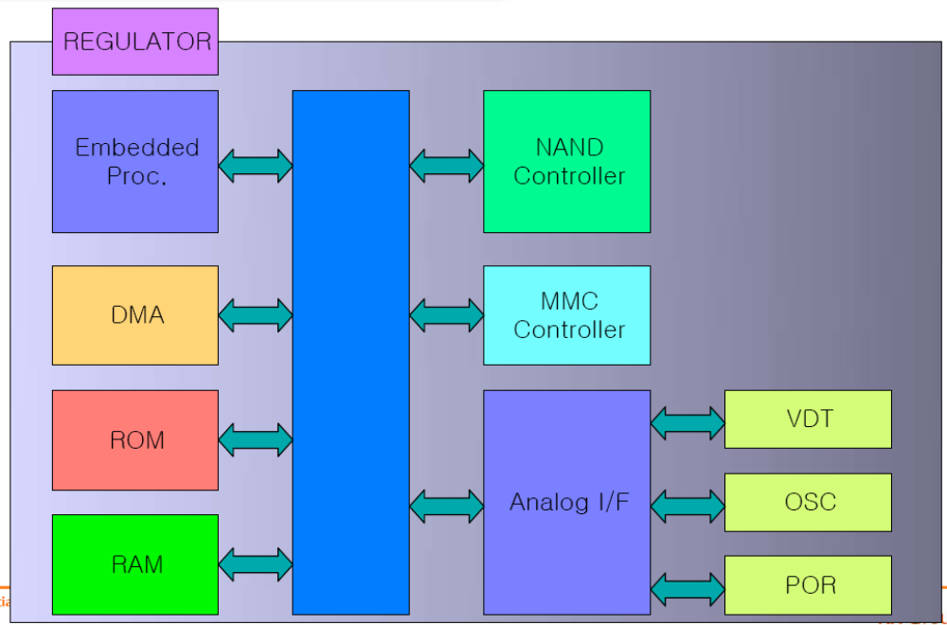
Detailed Block diagram

Slide 5
일정
[Project : 11 months]
Unit: Month
기준시점
4/1
7/1
8/1
10/1
3 | 1 | 2 | 3 | 2
IP Design
FPGA Test
Top Test Sim
FAB Process
M/P Test
FPGA B’D
RTL Freeze
FAB Out
Completed
On-board Test

Slide 6
Block diagram
제거
PLL
Internal
ROM
(5 K Bytes)
DMA
GPIO
On Chip
OSC
8051
Internal
Bus
Internal
SRAM
(8 K Bytes)
VDT
POR
MMC
Card IP
Regulator
???
ISP Channel
NAND
Controller

Slide 7
Status
FPGA B/D
  Schematic 완료
  Artwork 및 기타 작업 진행 중
  5/31일 입고 예정
IP Design
  NAND Controller (80%)
  R/S ECC (20%)
IP purchase
  8051
  etc..
S/W
  Layer define

Slide 8
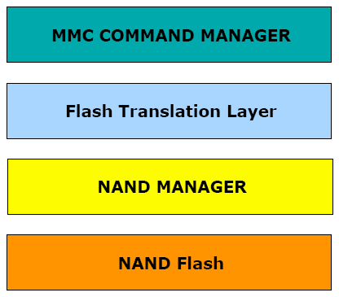
Software Layer
Standard 분석 작업 진행 (30%)
S/W Layer 작업 진행 중 (50%)

Slide 9
FPGA Board Block diagram
7 Seg 4 Digit
LED
20 Pin
ㄱ Type Header
40 Pin Socket
FPGA
X3S5000
40 Pin Socket
MMC 3.1 I/F
Power
ROM Emulator
Socket
OSC
MMC 4.0 I/F
20 Pin Female Socket

Slide 10
FPGA Board Block diagram
7 Seg 4 Digit
LED
40 Pin Header
40 Pin Socket
FPGA
X3S5000
NAND Flash
40 Pin Header
40 Pin Socket
Power
ROM Emulator
Socket
OSC

Slide 11
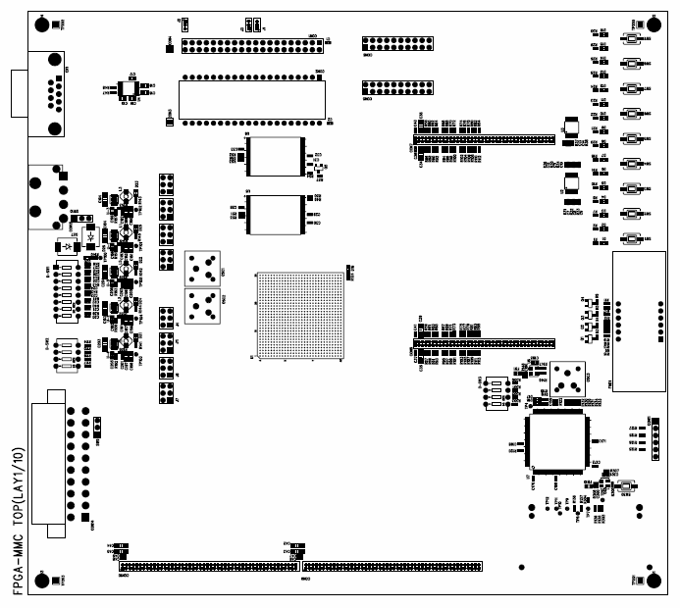
7 Seg 4 Digit
LED
40 Pin Socket
FPGA
V4LX60
40 Pin Socket
Power
ROM Emulator
Socket
OSC

Slide 12
Issue
1. 추가 기능
  MMC 4.2 지원
  SD Card I/F 지원
2. 양산시의 Gang Writer 지원 여부
  메버릭사 와 미팅 후 세부 진행을 결정할 수 있음.
3. MMC/SD Card 최신 표준 사양서

